Slide 1

EAGLE WORKSHOP 1
ILLINI FORMULA ELECTRIC
9.24.17

Slide 2

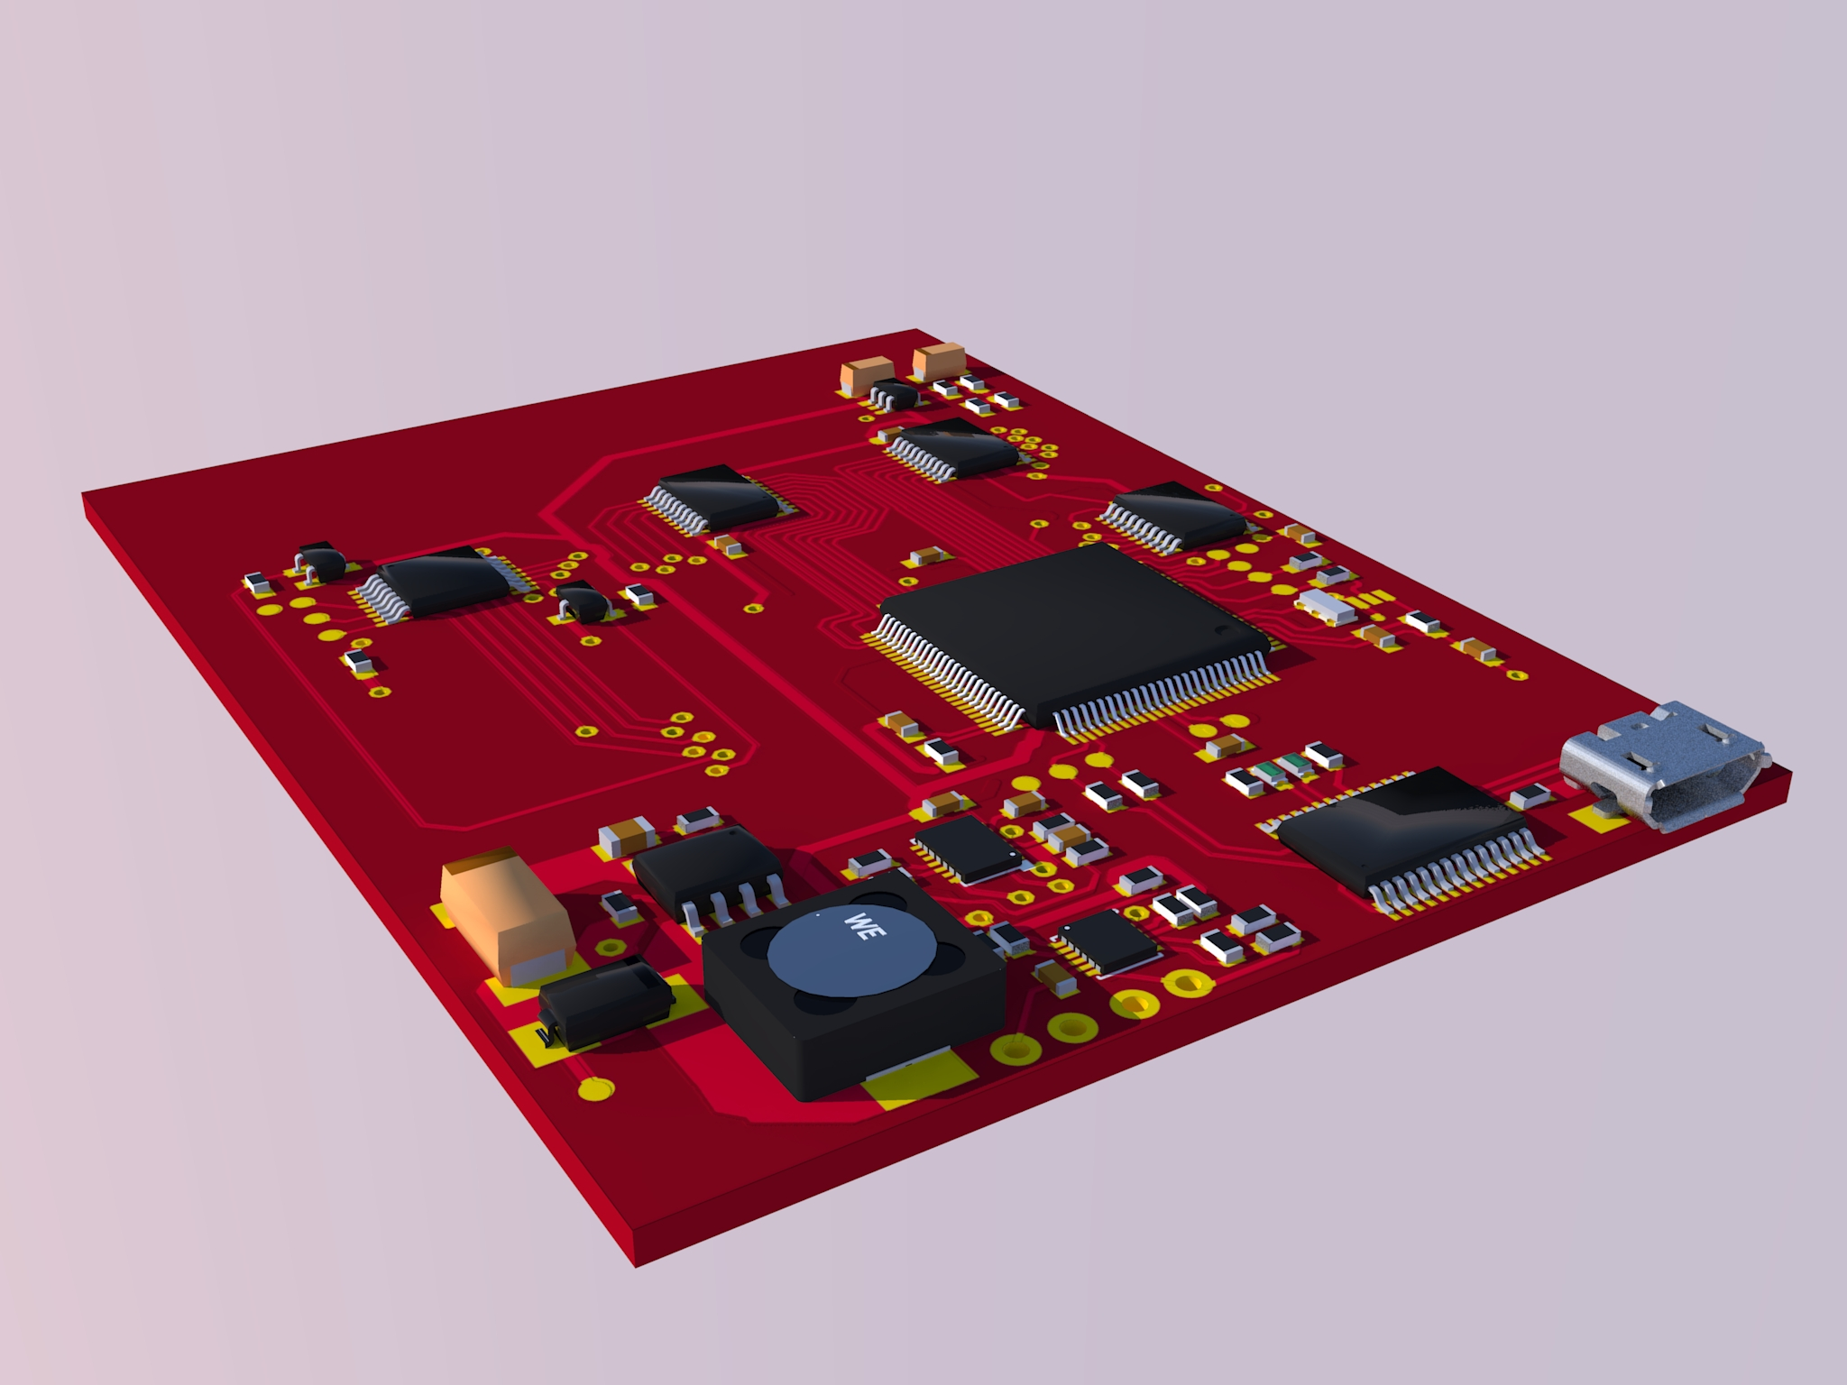
What is Eagle?
Eagle is an EDA tool that we use to design all of our schematics as well as layout all of our Printed Circuit Boards. It allows us to design circuits with a variety of different devices and packages.
It is free for students and can be downloaded HERE.

Slide 3
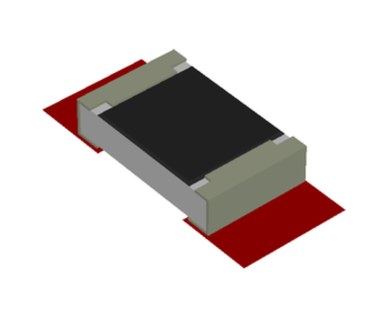
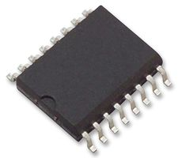
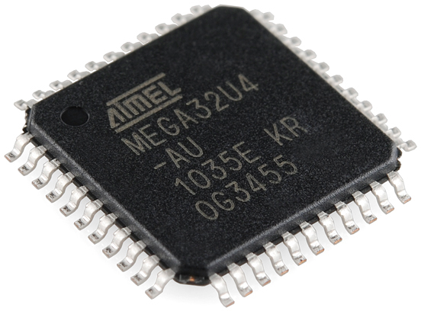
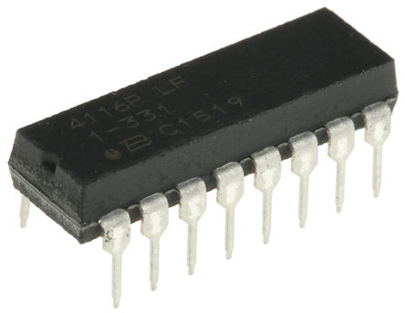
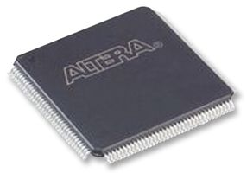
Parts and Packages
The package is the housing for the device itself and there are thousands of different package types.
Our team prefers through hole packages but we also use the larger surface mount packages if space is a constraint. Smaller packages and BGAs are nearly impossible to solder with our current tools.
Some packages are easier to route with so also keep that in mind as you design
0805 - Resistors/Capacitors/Diodes
SOIC – Smaller discrete logic chips
QFP – Micro Controllers, FPGAs, etc.
Through Hole
TQFP – Micro Controllers, FPGAs, etc.

Slide 4
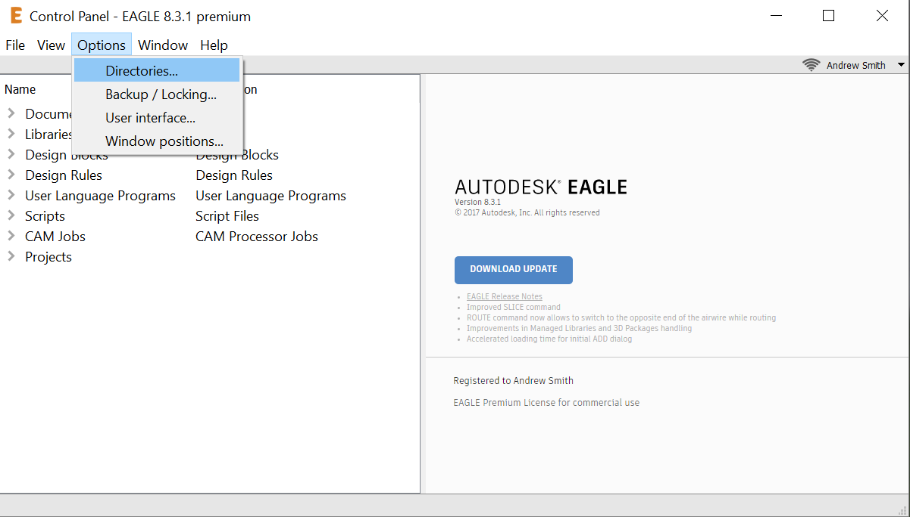
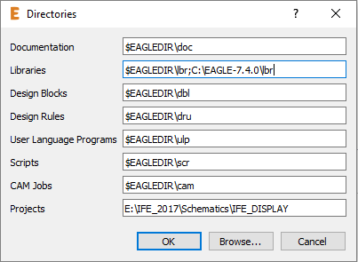
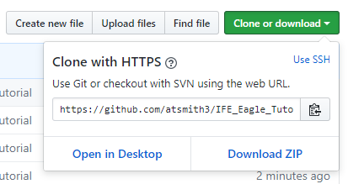
Getting started
Download Eagle & Create an Autodesk account with your student email.
Download the zip of libraries and the 2n2222 datasheet from HERE. And extract to the folder of your choice.
Open eagle and go to Options->Directories...
Click on the “Libraries” line and add a semicolon and click browse.
Go to your newly extracted libraries folder click “Select folder” then hit “Ok” now the libraries are added to your path.

Slide 5
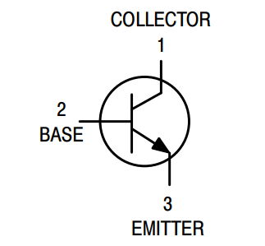
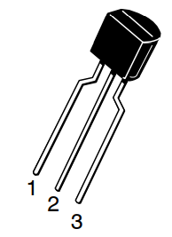
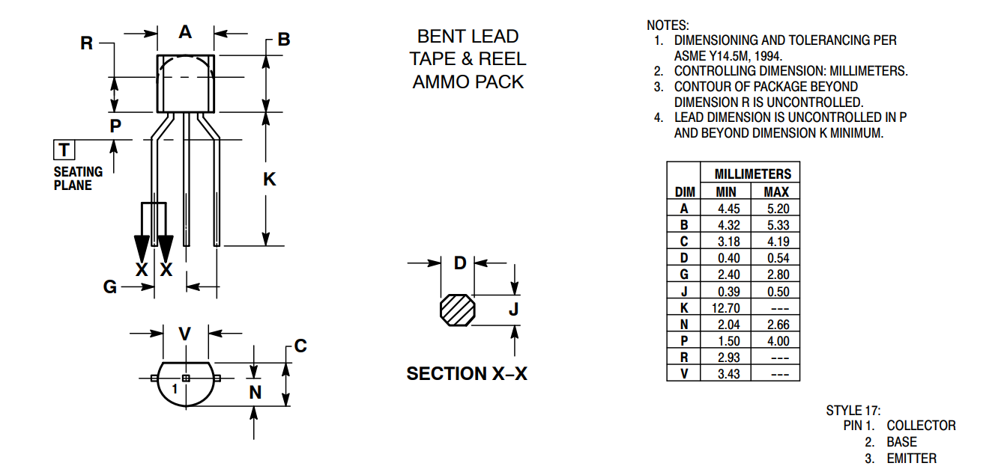
Part 1: Creating a Custom Part
Even though there are many libraries out there fro eagle, sometimes you just can’t find the part you need in a preexisting library.
So you will have to create a custom part, this consists of 3 general steps:
Creating a Symbol
Creating a Package
Combining Symbol and Package into a part
We will walkthrough creating a simple p2n2222 BJT

Slide 6
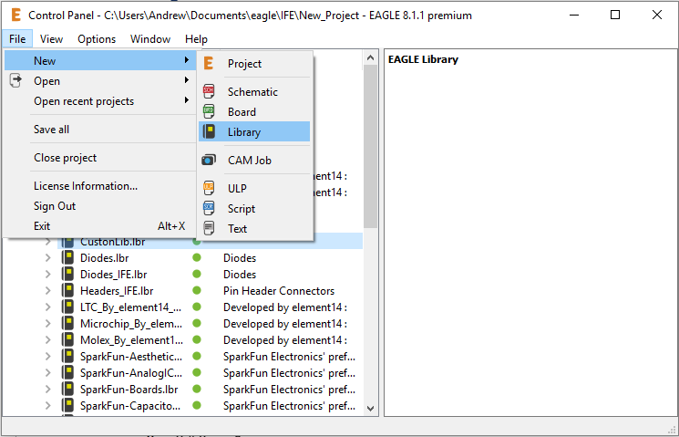
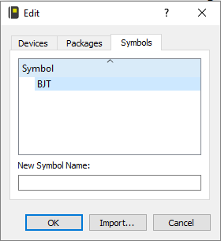
Creating a new Library
To create a new library:
Select File->New->Library
Select File->Save As
Save into the same libraries folder we unzipped earlier as “Tutorial”
Click on the Symbol with a drop down arrow button It will open the edit window.
Type BJT in the “New Symbol Name” field and hit OK. The Symbol editor should launch.

Slide 7
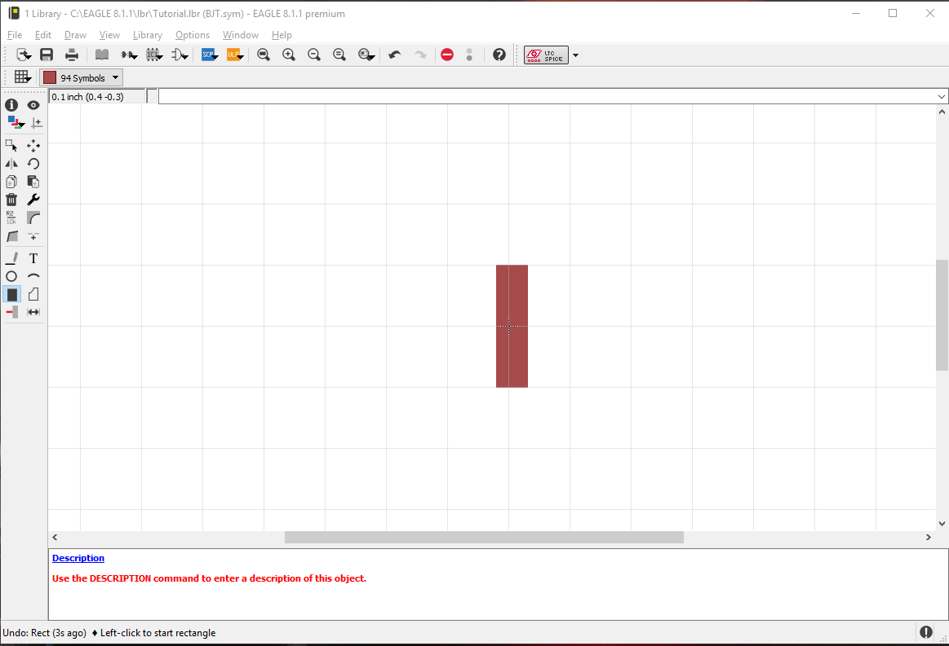
Drawing the Symbol
To draw the symbol go to View->Grid and make sure your primary grid is 0.1 inch and your ALT grid is 0.01 inch.
Select the rectangle tool from the sidebar, and while holding down the ALT key draw a rectangle from (-0.02,0.1) to (0.03,-0.1)

Slide 8
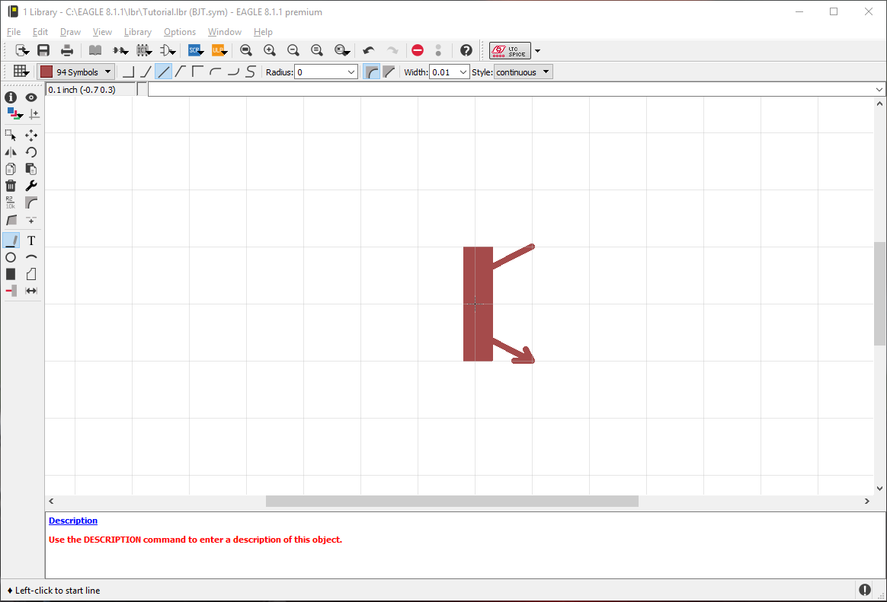
Drawing the Symbol
Next select the Line tool and select wire bend style 2.
Holding down the ALT key draw two lines from points (0,0.05)->(0.1,0.1) and (0,-0.05)->(-0.1,-0.1).
*Note: the line will automatically continue from the last point pressed so release the ALT key and hit ESC to start a new line.
Finally add a small arrow of two small lines to the lower long line.

Slide 9
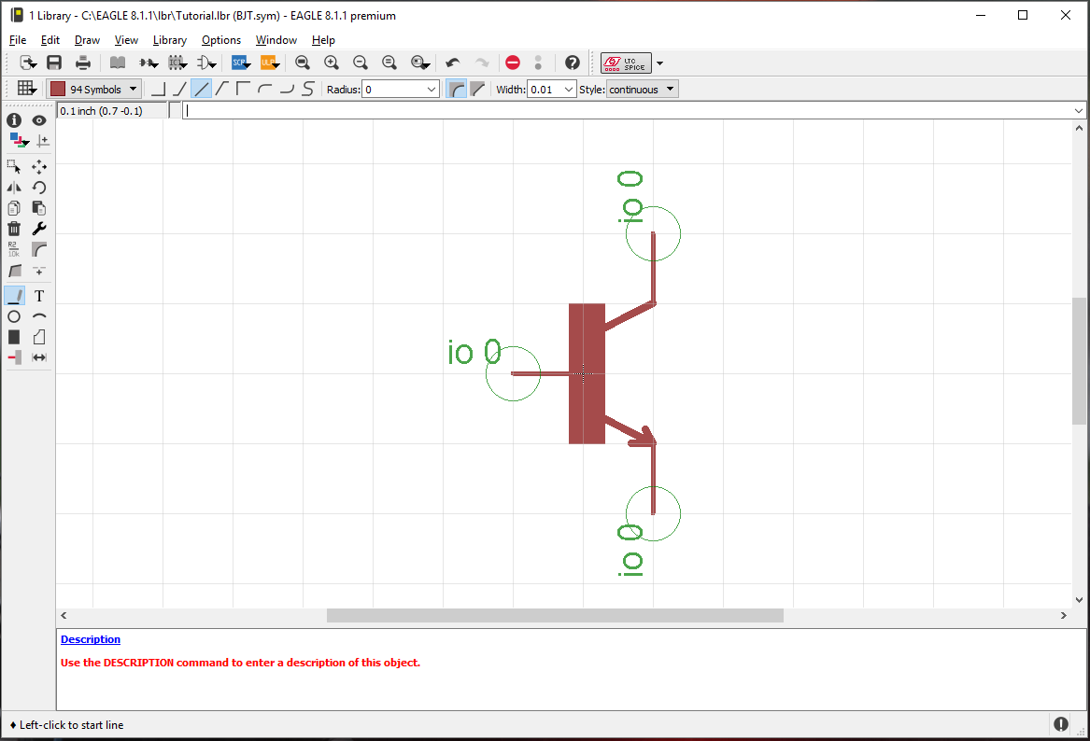
Drawing the Symbol: Pins
Next we will add the pins to the symbol. Pins enable the schematic and board software to understand that a net is connected to a device.
Click on the “Draw Pin” symbol and at the top select “Short”
Using the mouse's right click to rotate the pin add three pins to our symbol as such

Slide 10
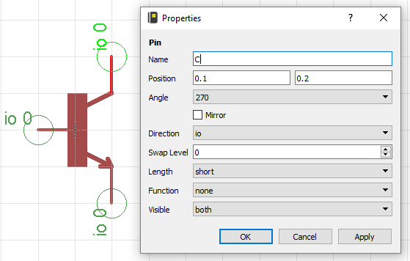
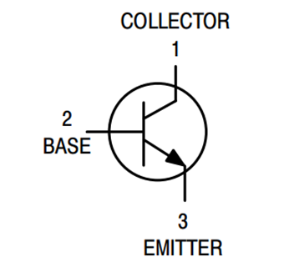
Drawing the Symbol: Pin Names
Next we will rename the pins to something meaningful.
Right click on the pin and click properties.
In the name field change the name to match the symbol in the datasheet:
C – Collector
B – Base
E – Emitter
This will make it much easier to link the symbol to the package.

Slide 11
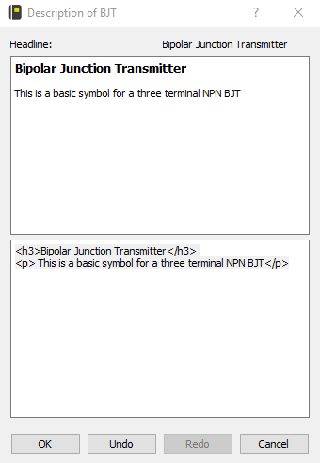
Drawing the Symbol: Description
Finally we will add a description to our BJT symbol. Click on the Description link in the bottom of the window, add some details about the device in HTML.
<h3>Bipolar Junction Transmitter</h3>
<p> This is a basic symbol for a three terminal NPN BJT</p>

Slide 12
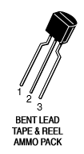
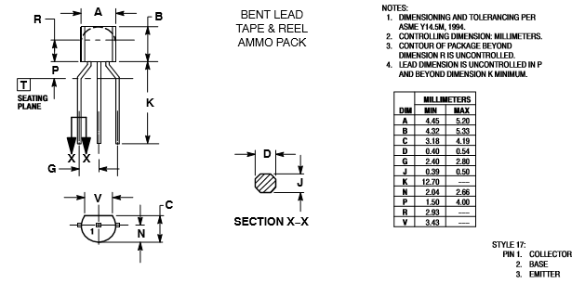
Creating the Package
Now that we have made the symbol save it, and then click on the IC button. Enter a new package name such as “TO_92_TAPE_REEL”.
Now we will look at the package dimensions part of the datasheet.
The important dimensions to note are the size of the pins/pads (D,J) and the spacing in between the pins and pads (G).

Slide 13
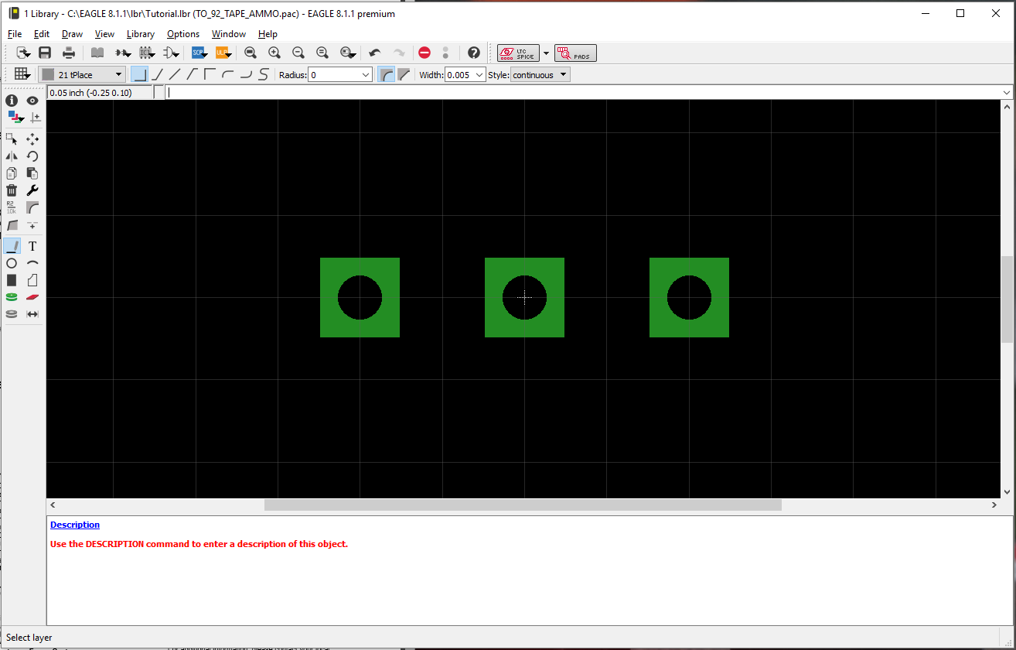
Creating the Package: Placing Pins
The package is a through hole so we will be placing Pads (The green circle button) If it was a surface mount chip we would be placing Surface Mount Pads.
Because the max tolerance of D and J never exceed 0.55 mm we chose a drill size with enough space to comfortably insert the pin and solder (0.02755 in) and the spacing G is on average 2.6mm we can place the pins at points (-0.1in,0in), (0in,0in), (0.1in,0in).

Slide 14
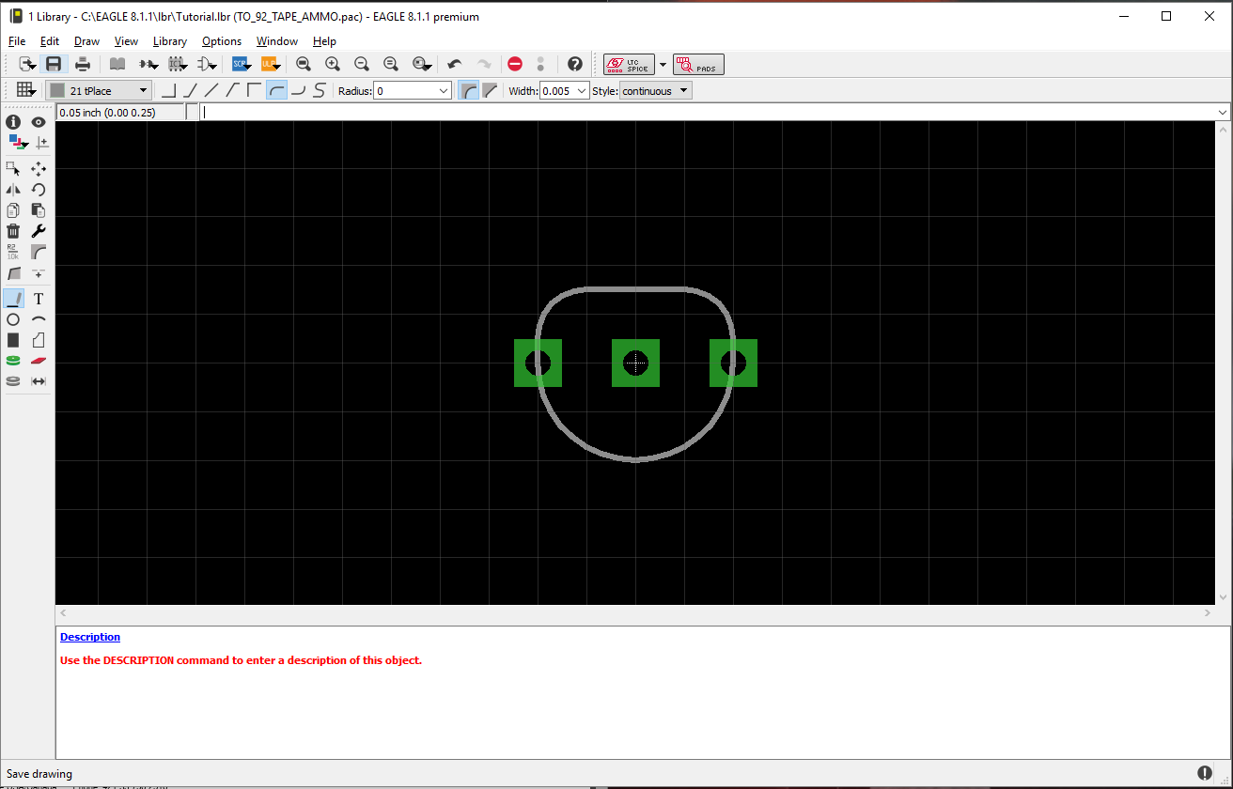
Creating the Package: Outline
Next we want to draw an outline of the part, this will help us when we layout the board so we don’t place parts too close together.
Click on the line tool and play around with wire bend styles 5,6 to draw a semicircle from (-0.1in,0) to (0.1in,0)
Next hold down the ALT key to draw a semicircle from (-0.1in,0) to (-0.05,0.075) and from (0.05,0.075).
Then connect the two arcs with a straight line. It gives us a good approximation of the part dimensions.

Slide 15

Creating the Package: Naming Pads
Next we will name the pads to correspond with the numbers on the package in the datasheet.
Right click on the pad and select properties.
Name the pins from left to right:
(3, 2, 1)
Add a description by clicking the blue description link.
<h3>TO-92 Tape and Reel Package</h3>

Slide 16
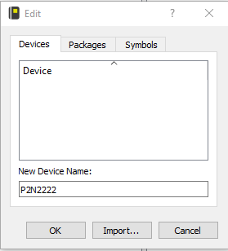
Creating the Device
Now that we have both a symbol and a package we can create the device itself.
Click on the symbol that looks like two AND gates and it will open the device edit window.
In the New Device Name field type “P2N2222” and click OK.

Slide 17
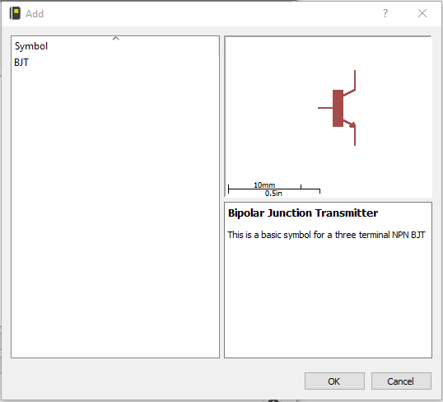
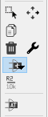
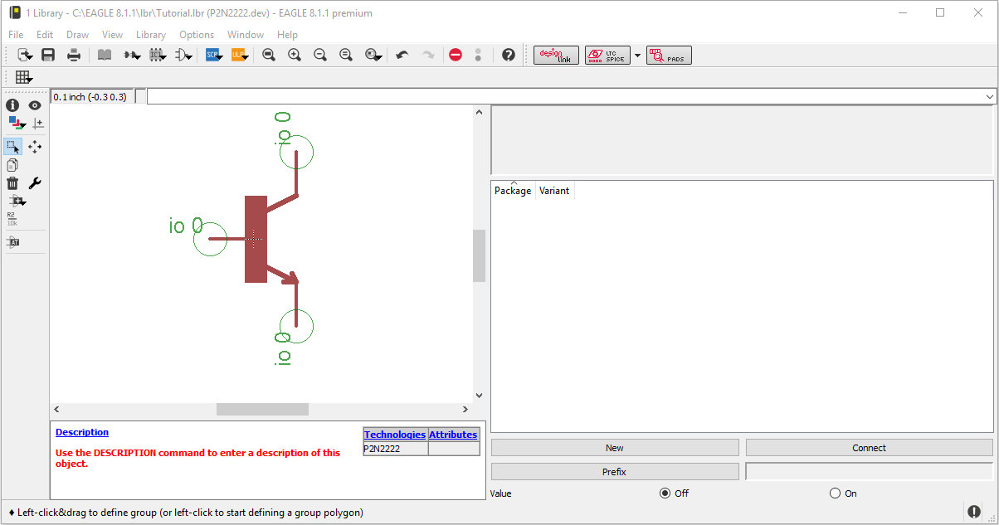
Creating the Device
On the left hand toolbar click on the “Add a Symbol” button and it should bring up a window with all of your symbols in your custom library.
Click on the BJT symbol we created earlier and click OK.
Place your symbol at (0.0,0.0) and hit ESC to exit the add mode.

Slide 18
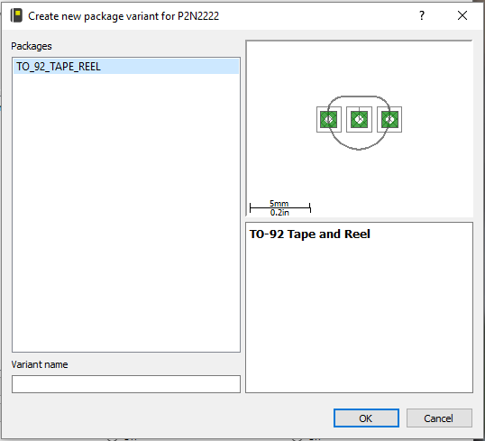
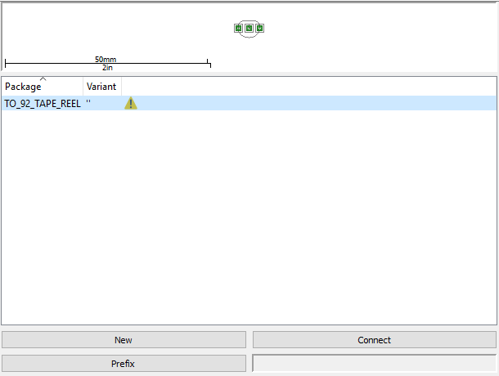
Creating the Device
Now in the right plane of the device window there are three buttons at the bottom, New, Connect, and Prefix.
Click New.
This will open the create new package variant window. Select the TO_92_TAPE_REEL and click OK.
A yellow caution triangle will appear next to the package indicating the pins and pads aren’t connected.

Slide 19
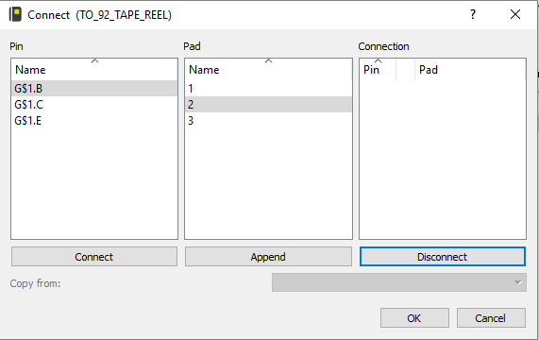
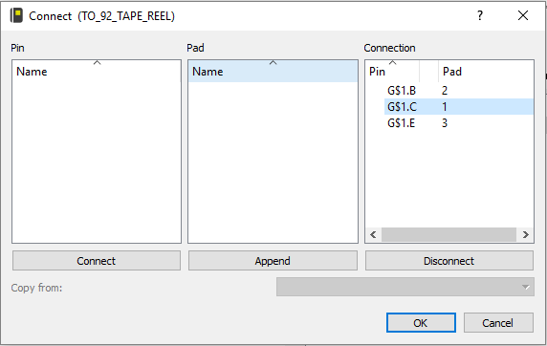
Creating the Device
To connect the pins make sure the package is highlighted and click the Connect button at the bottom right of the window.
This will launch the Connect window
Using the data sheet symbol and pinout highlight B in the pin list and 2 in the pad list and click “Connect”
The pin and pad will now appear in the connection list.
Do the same for C and 1 and E and 3.
Click OK to finish connecting.

Slide 20
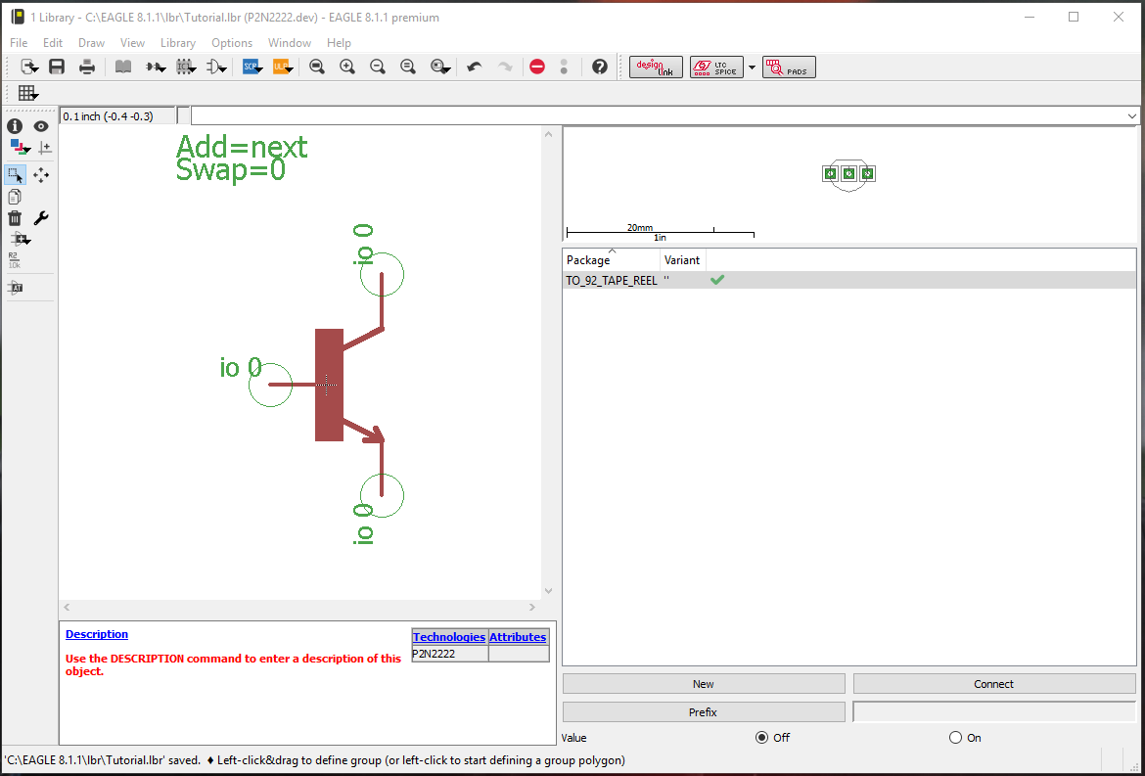
Creating the Device
Now there should be a green check mark in the package window signaling that all the pins are accounted for.
Congrats you’ve just modeled your first device in EAGLE!
You can give your device a description at this point and hit save.
Exit the window to return to the eagle start window.

Slide 21
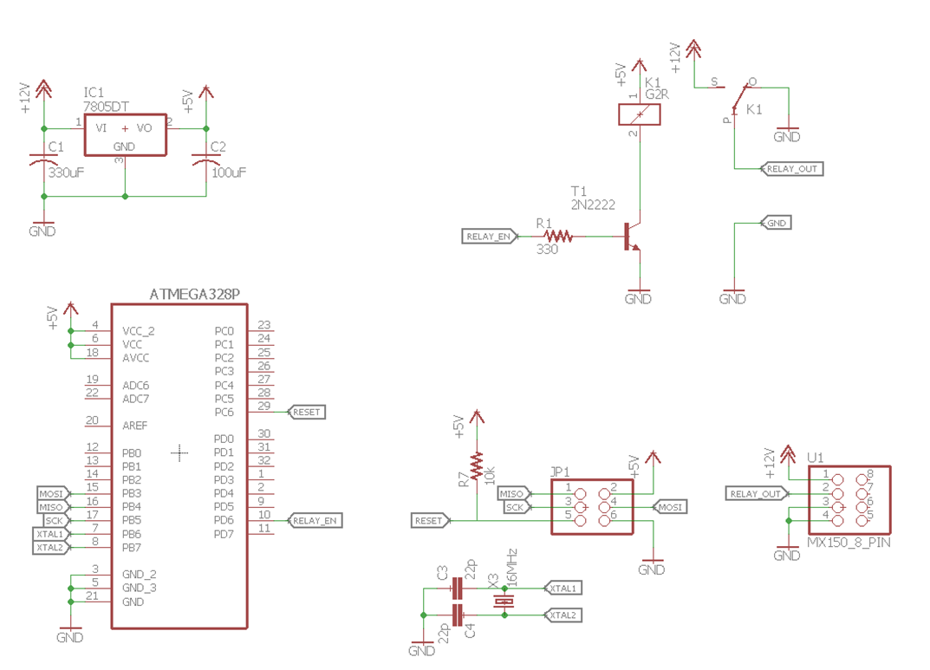
Part 2: Creating the Relay Driver
From the eagle start window click File->New->Project
Name it “Relay_Driver_Tutorial”.
Right click on the project and select New->Schematic
This will launch the schematic editor window.
Click the Add a Part button on the left hand side tool bar

Slide 22
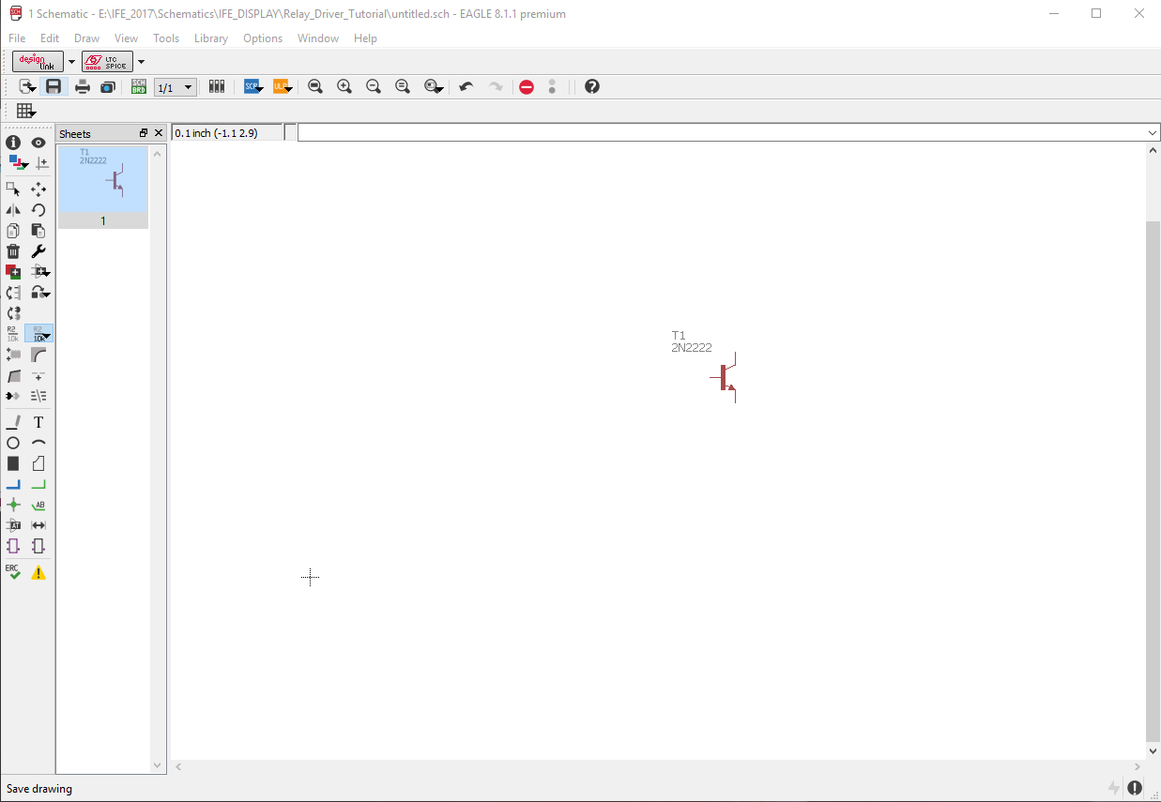
Part 2: Creating the Relay Driver
This will open a window with a list of all the libraries.
It looks intimidating at first but after a while its super easy to find components and you will get more familiar with packages and components.
Scroll down to the Tutorial library that we added click on the P2N2222 and click OK.
Place it in the workspace.

Slide 23
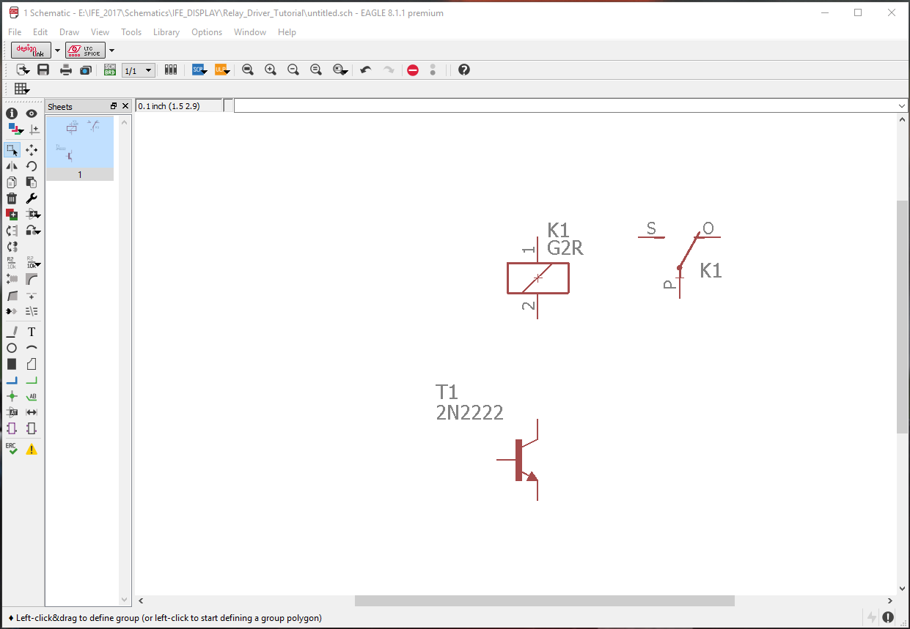
Part 2: Creating the Relay Driver
Next we will add the relay
Scroll to find the “Relays” library and expand.
Add the part G2R to the schematic just above the transistor.
The relay needs 150mA of current to be driven so we need the BJT to amplify the current through the relay. A microcontroller can only supply about 30mA without damaging a pin.

Slide 24
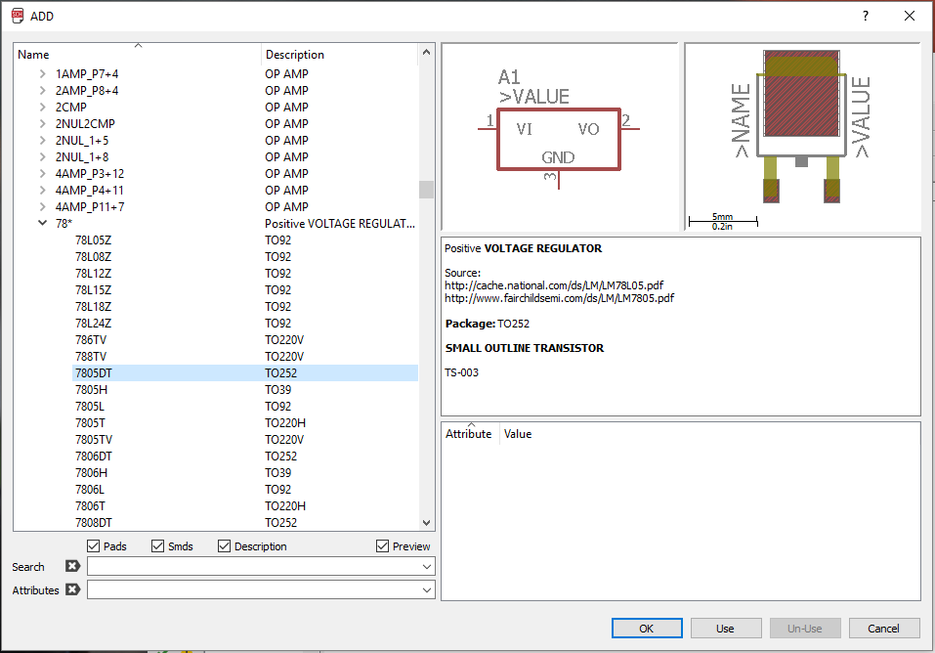
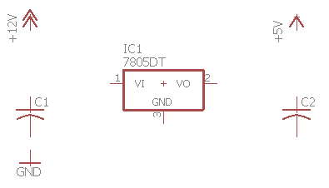
Part 2: Creating the Relay Driver
Next we will add sources to our project. Go to the add part and find the supply1 library.
Add a +12v and a +5v to the project
As well as a GND
Next find the “linear” library expand and find the 78* folder. Then select the 7805 which will regulate our 12V supply to 5V.
Next find the “rcl” library and expand the C-US folder and find the part C-USC0805. This is an 0805 surface mount capacitor. Place 2 on the schematic.

Slide 25
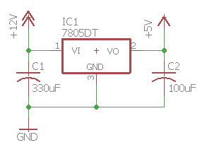
Part 2: Creating the Relay Driver
Next we will assign some values to those capacitors. 330 micro Farads on the input side100 micro Farads on the output side are good sizes for low power electronic circuits. And will help filter high frequency noise from the input signal.
Use the “Value” tool to assign the capacitors a value.
The use the wire tool to connect the power circuitry.

Slide 26
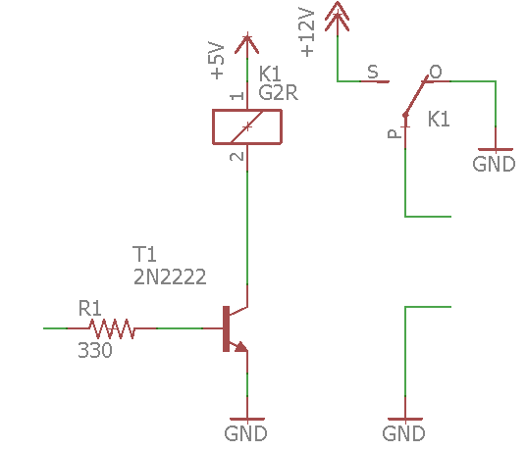
Part 2: Creating the Relay Driver
Next we will wire the relay. We need to add a 330 ohm resistor to the input of our BJT.
Again open the add part and find the RCL library and expand the R-US_ folder and add a R-US_R0805.
Assign it a value of 330 ohms
Then use wires and copy your 12, 5 and GND sources to connect the relay and transistors as such.

Slide 27
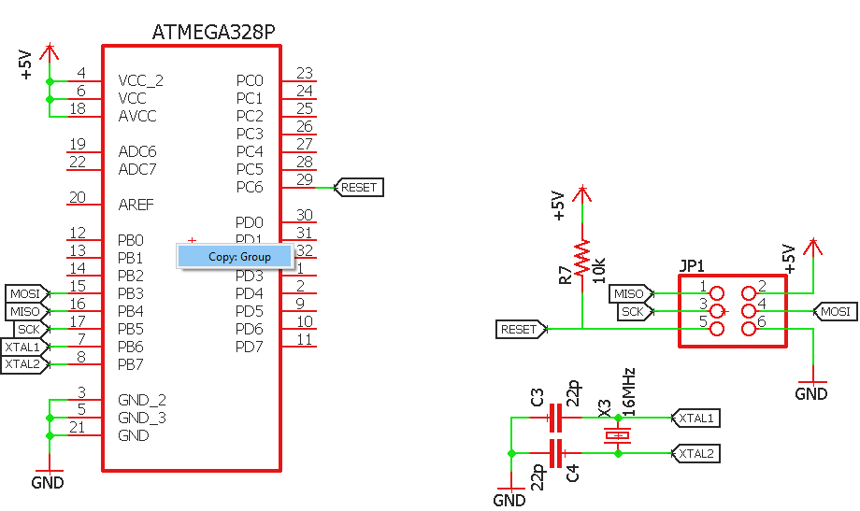
Part 2: Creating the Relay Driver
Next lets add a device to control our relay.
In the zip file open the atmega.sch
This is a QPF package ATmega328P and its programming header
Use the group tool to select all the parts so they are highlighted
Right select the copy tool and right click Group: Copy
Now open the other schematic and select Edit->Paste and click to place the circuit.

Slide 28
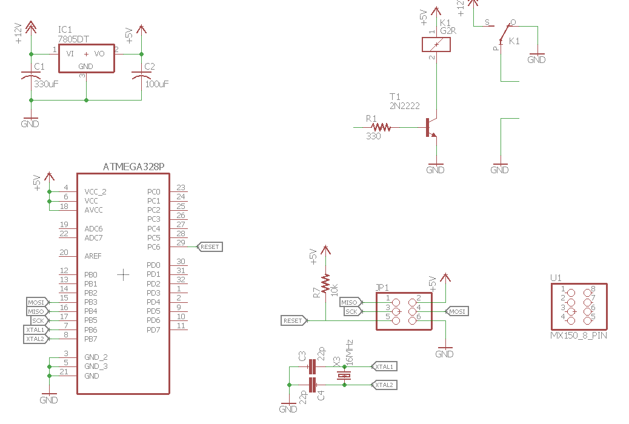
Part 2: Creating the Relay Driver
The final thing our circuit needs is a connector so it can interface with the rest of the car.
We use Molex MX150 – 8 and 20 pin variants on our car to connect with the wiring harness.
We chose these because they are easy for E.M.I. to integrate into their housings.
Click the add part find the “Connectors” library and select MX150_8_PIN.

Slide 29
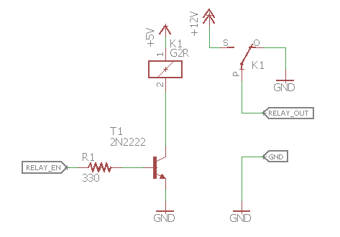
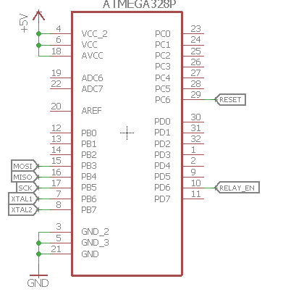
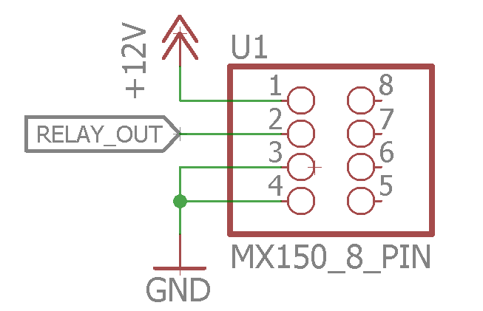
Part 2: Creating the Relay Driver
The last step is to finish the connections. Select the signal tag tool and add names to the nets.
Add a wire to in PD6 of the ATmega and add a tag and name it “RELAY_EN”
Add four wires to pins 1 through 4 of the Molex MX150.
1 - +12V
2 – RELAY_OUT
3 – GND
4 – GND

Slide 30
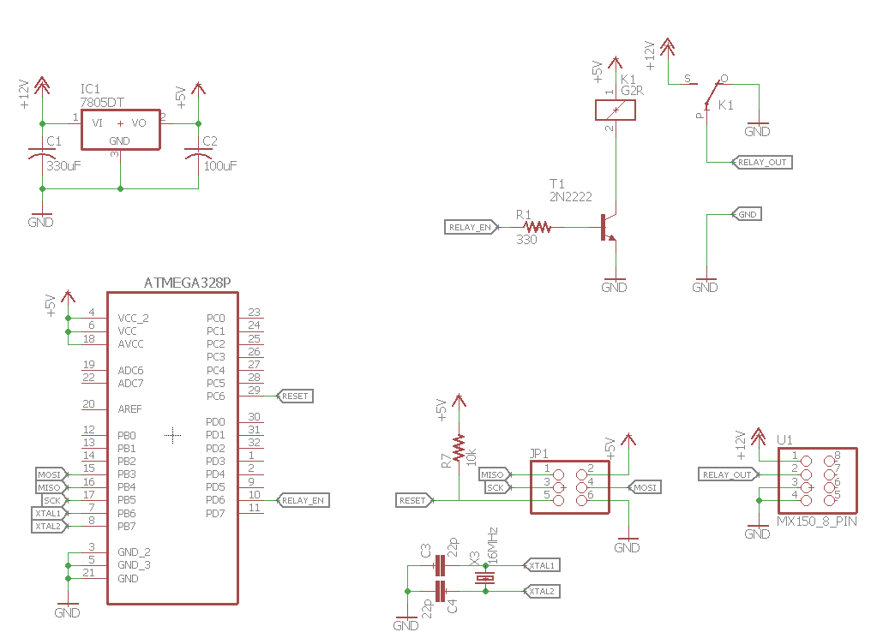
DONE!!
Congratulations you have just created a fully functioning relay driver circuit. We will go over creating the PCB Layout at a later time but feel free to use this circuit to experiment with the Layout Editor!
I have also included the version of the circuit that I made and based this tutorial off of in the ZIP.

